Slide 1



Prediction of Atomic Web Services Reliability Based on K-means Clustering
ESEC/FSE, Saint Petersburg, Russia, 2013.
Marin Silic, Goran Delac and Sinisa Srbljic
Consumer Computing Laboratory
Faculty of Electrical
Engineering and Computing
University of Zagreb, Croatia
http://ccl.fer.hr/
http://www.fer.hr/
http://www.unizg.hr/

Slide 2
Outline
Motivation
Reliability in SOA
State-of-the-art
CLUS Approach
Evaluation
Conclusion

Slide 3


Motivation
Contemporary web applications - SOA
A 2
A 4
A 1
A 5
A 3
Web Application
Notes:
Contemporary web applications are composite, built out of modules that pull content from various sources worldwide. The modules are often implemented using different technologies, but the implementation is guided by the set of rules and principles defined in SOA. In SOA, basic functionalities are usually implemented using atomic reusable services, which are then composed using special languages into composite services that support more advanced functionalities.

Slide 4
Process of candidates selection
A 2
A 1
A 2
A 1
A 4
A 4
A 3
A 3
A 5
A 6
Composite service
Repository
Functional properties
Nonfunctional properties
Ensure the desired functionality
Reliability
…
Availability
Impact Qos & QoE
Notes:
While creating composite services, the process of potential candidates selection is crucial. Candidates’ functional attributes ensure correct logical functioning, meaning the desired functionality of the composite service, while nonfunctional properties including various dependability attributes such as reliability, availability and safety may have a significant impact on perceived quality of the composite service. In this paper we focus on atomic web services modeling.

Slide 5


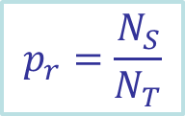



“Reliability on demand” definition
REQ
A 2
A 4
A 1
A 6
Application
RES
A 3
A 5
$$t_{REQ}$$
$$t_{RES}$$
Service Oriented System
$$t_{RES} − t_{REQ}<∆t$$
The ratio of successful against total number of invocations
$$p_{r}=\frac{N_{S}}{N_{T}}$$
Past
Invocation
Sample
Notes:
Based on the adopted “reliability on demand” definition which is more suitable for service oriented systems because service invocations are discrete and reasonably sparse events, a service reliability can be defined as the probability that a service invocation will complete successfully under the specified time constraints. According to that definitions service reliability can computed using the past invocation sample as the ratio of the number of successful service invocations against the number of total performed invocations.

Slide 6

Drawbacks/Obstacles
Client’s vs. provider’s perspective
Service invocation context
Depends on the quality of the sample
Acquiring a sample proves to be a difficult task
A 1
A 2
A 3
A 1
QoS₂
QoS
QoS
QoS
Client
A 5
A 4
A 6
QoS
QoS
QoS
QoS₁
Client
Service Provider
QoS
≠
QoS₁
≠
QoS₂
Notes:
However, there are some drawbacks regarding such a computed service reliability. For instance, the overall reliability value observed by the service provider might be inaccurate for a particular user. In fact, different users in different geographical locations can experience quite different nonfunctional properties while invoking a service. All these mentioned fluctuations in perceived reliability are related to the variability stemming from the service invocation context.
Another drawback of the reliability computed in this manner, is that it highly depends on both quality and quantity of the past invocation sample. In order to estimate the reliability accurately, the comprehensive past invocations sample needs to be collected. Acquiring a comprehensive sample proves to be a difficult task.

Slide 7
Insight to the Solution
To overcome the drawbacks and obstacles
  Collect partial, but relevant past invocation sample
  Utilize prediction methods to estimate the reliability for the missing records
Notes:
One possible approach to overcome the obstacles and drawbacks is to (1.) collect partial, but relevant past invocation sample considering both users and providers feedback, and (2.) to utilize prediction methods to estimate the reliability for the missing records.

Slide 8
State-of-the-art
Collaborative filtering
ui matrix
n services
m,n >>
p₁₁
?
…
p_{1i}
…
?
p_{1n}
?
matrix is extremely sparse
?
p₂₂
…
?
…
?
?
?
m users
…
…
…
…
…
…
…
…
p_{u1}
?
…
p_{ui}
…
?
p_{un}
?
number of values to predict
…
…
…
…
…
…
…
…
p_{m1}
?
…
p_{mi}
…
?
p_{mn}
?
Notes:
The most successful approaches for predicting the reliability of atomic web services are based on collaborative filtering technique commonly used in the state-of-the-art recommendation systems such as YouTube, Reddit, Amazon and etc.
Collaborative filtering employs user-item (ui) matrix to store reliability records for m users and n services. Each user-item pair value pUI in the matrix represents the reliability of the service i experienced by user u. In real-service oriented systems, having substantially large number of users and services where each users visits only a very limited subset of services and new ui pairs arise in real time, this user-item matrix is extremely sparse having a number of missing cells capturing reliability whose values need to be predicted.

Slide 9
Collaborative filtering
Computes the similarity using PCC
Matrix can be employed in two different ways
IPCC
approach
p₁₁
?
…
p_{1i}
…
?
p_{1n}
?
p₂₂
…
?
…
?
?
UPCC
approach
Hybrid approach
…
…
…
…
…
…
…
p_{u1}
?
…
p_{ui}
…
?
p_{un}
…
…
…
…
…
…
…
p_{m1}
?
…
p_{mi}
…
?
p_{mn}
Notes:
The collaborative filtering computes similarity relations among different entities using Pearson Correlation Coefficient (PCC) which is often used in modern recommendation systems. The matrix can be employed in to different ways to perform the collaborative filtering tasks. The first approach, user-based approach, estimates missing values by using available records from the most similar users, while the item-based approach, estimates the missing values considering most similar items. However, the researchers have demonstrated that better prediction accuracy is obtained with their Hybrid approach which considers both impacts of similar users and similar services. The Hybrid approach utilizes a linear combination of UPCC and IPCC to produce the final prediction.

Slide 10
Disadvantages of Collaborative Filtering
Scalability
  Having millions of users and services – these approaches do not scale
Accuracy in dynamic environments
  Internet is a highly dynamic system
  Do not consider environment conditions
Notes:
Although the existing collaborative filtering based approaches achieve promising results they manifest some serious disadvantages. First, collaborative filtering requires storing reliability value for each user-service pair. Given millions of users and services in real service oriented systems causes potential scalability issues and questions the ability of real time prediction performance for these approaches.
Furthermore, collaborative filtering provides accurate recommendations in static environments where the collected data records are relatively stable. This means that the records remain up to date for a reasonably long period of time (e.g. movie ratings, product recommendations). However, service-oriented systems are deployed on the Internet, which is a very dynamic environment where service providers register significant load variations during the day. In such a dynamic environment, user perceived service reliability may
considerably differ depending of the actual time of invocation and environment conditions need to be considered to produce accurate predictions.

Slide 11
CLUStering
To address scalability
  Applies the principle of aggregation
  Reduces the redundant data by clustering users and services using K-means
To improve the accuracy
  Introduces environment-specific parameters
  Disperses the collected data across the additional dimension
Notes:
The CLUS approach aims to address two main disadvantages of the state-of-the-art. The name CLUS comes from clustering, because the approach uses K-means clustering algorithm.
To address the scalability, CLUS applies the principle of aggregation and reduces the redundant data by grouping users and services into respected users and services clusters according the their reliability performance using K-means clustering algorithm.
To improve the accuracy, the CLUS approach considers all, user-, service- and environment-specific parameters of the service invocation context. The existing approaches implicitly consider only user- and service-specific parameters. By contrast, CLUS introduces the environment-specific parameters that describe load conditions in the environment at the actual time of the service invocation. Additionally, CLUS disperses the collected data across the additional dimension that corresponds with the environment conditions.

Slide 12
CLUS Overview
Data Clustering Phase
Users
Clustering
(1c)
(3c)
Environment Clustering
Creation
of D
(5c)
Raw
Data
Clustered
Data
(2c)
Services
Clustering
(4c)
Prediction Phase
r(u, s, t)
Prediction
p(r)
Notes:
The CLUS approach is done in two phases. The clustering phase is done only once prior to prediction phase. We cluster different time windows into a set of different environment conditions, we cluster users and services into respected users and services clusters and we create three–dimensional space D that represents clustered data where each dimension of D corresponds to the respected environments, users, and services clusters. The second phase is the prediction phase which uses both raw and clustered data to estimate the reliability for an ongoing request.

Slide 13






Environment-specific Clustering
Set of environment conditions
$$E=\{e_{1 }, e_{2},…, e_{i},…,e_{n}\}$$
e₁
e₂
…
e_{i}
…
e_{n}
K-means
clustering
$$\overline{p_{w_{1}}}$$
$$\overline{p_{w_{2}}}$$
$$\overline{p_{w_{i}}}$$
$$\overline{p_{w_{c}}}$$
w₁
w₂
w_{i}
w_{c}
A day
…
…
t₀
t₁
t_{i-1}
t_{i}
t_{c-1}
t_{c}
$$\overline{p_{w_{i}}}=\frac{1}{|W_{i}|}\sum_{r∈W_{i}}{p_{r}}$$
Notes:
First, we define a set of different environment conditions, where n is an arbitrary number of distinct environment conditions.
Then, we divide a day into an arbitrary number of time windows, where each window wi is determine by its start time ti and its end time ti+1.
Next, we assign to each time window the average reliability value according to the following formula. |Wi| is the set of collected reliability records within the time window wi.
Finally, we perform K-means clustering of time windows into the appropriate environment conditions clusters according to their average reliability values.

Slide 14












User-specific Clustering
Set of users clusters
$$U=\{u_{1 }, u_{2},…, u_{i},…,u_{m}\}$$
u₁
u₂
…
u_{i}
…
u_{m}
$$\vec{p_{r}}=\{\overline{{p_{e}}_{1 }}, \overline{{p_{e}}_{2}},…, \overline{{p_{e}}_{i}},…,\overline{{p_{e}}_{n}}\}$$
$$\overline{p_{e_{1}}}$$
$$\overline{p_{e_{2}}}$$
$$\overline{p_{e_{i}}}$$
$$\overline{p_{e_{n}}}$$
K-means
clustering
e₁
e₂
…
e_{i}
…
e_{n}
…
$$\vec{p_{r}}$$
$$\vec{p_{r}}$$
$$\vec{p_{r}}$$
…
$$\vec{p_{r}}$$
$$\vec{p_{r}}$$
$$\vec{p_{r}}$$
$$\vec{p_{r}}$$
$$\vec{p_{r}}$$
$$\vec{p_{r}}$$
Notes:
First, we define a set of different users groups, where m is an arbitrary number of distinct users groups.
In the next step, for each user, we calculate a reliability vector pr, where each vector’s component pei corresponds with the average reliability perceived by associated user during the environment conditions ei.
Then we assign to each user his reliability vector and we perform clustering of users using K-means algorithm according to the reliability vectors values.

Slide 15








Service-specific Clustering
Set of services clusters
$$S=\{s_{1 }, s_{2},…, s_{i},…,s_{l}\}$$
s₁
s₂
…
s_{i}
…
s_{l}
$$\vec{p_{r}}=\{\overline{{p_{e}}_{1 }}, \overline{{p_{e}}_{2}},…, \overline{{p_{e}}_{i}},…,\overline{{p_{e}}_{n}}\}$$
$$\overline{p_{e_{1}}}$$
$$\overline{p_{e_{2}}}$$
$$\overline{p_{e_{i}}}$$
$$\overline{p_{e_{n}}}$$
K-means
clustering
e₁
e₂
…
e_{i}
…
e_{n}
…
$$\vec{p_{r}}$$
$$\vec{p_{r}}$$
$$\vec{p_{r}}$$
…
$$\vec{p_{r}}$$
$$\vec{p_{r}}$$
$$\vec{p_{r}}$$
$$\vec{p_{r}}$$
$$\vec{p_{r}}$$
$$\vec{p_{r}}$$
Notes:
First, we define a set of user different service groups, where l is an arbitrary number of distinct service groups.
In the next step, for each service, we calculate a reliability vector pr, where each vector’s component pei corresponds with the average reliability perceived while using the associated service during the environment conditions ei.
Then we assign to service its reliability vector and we perform clustering of services using K-means algorithm according to the reliability vectors values.

Slide 16

Creation of Space D
Each record, r(u, s, t), is associated to the belonging clusters u_{k} , s_{j} , e_{i}
Each entry in D is computed as follows:
R contains all the records that belong to clusters u_{k} , s_{j} , e_{i}
$$D\left[u_{k}, s_{j},e_{i}\right]= \frac{1}{|R|}\sum_{r∈R}{p_{r}}$$
Notes:
After performing environment conditions, users and services clustering each available reliability records r(u,s,t) is associated with the clusters it belongs to: uk, sj, and ei and each entry in D can be calculated according to the presented formula. The equation simply computes the average value over all the available records that belong to the associated clusters.

Slide 17


Prediction
Assuming an ongoing r_{c}=(u_{c}, s_{c}, t_{c})
First, it checks the collected sample:
If H is not empty
Otherwise,
$$H=\{r_{h}|u_{c}=u_{h}⋀s_{c}=s_{h}⋀t_{c},t_{h}∈w_{i}\}$$
$$p_{c}=\frac{1}{|H|}\sum_{r∈H}{p_{r}}$$
$$p_{c}=D\left[u_{k},s_{j},e_{i}\right], u_{c}∈u_{k}∧s_{c}∈s_{j}∧t_{c}∈e_{i}$$
Notes:
Lets assume we have a ongoing request whose reliability needs to be predicted. First, we check the collected past invocation sample for measured reliability records that have the same invocation context parameters as rc. The set H presents those records. If the set is not empty we use collected reliability records to estimate the reliability. Otherwise, we estimate the reliability value using the data stored in D according to the clusters in which the ongoing request belongs to.

Slide 18
Evaluation
Comparison with the state-of-the-art
  UPCC
  IPCC
  Hybrid
Evaluation measures
  Prediction accuracy
    MAE, RMSE
  Prediction performance
    Aggregated prediction time
Notes:
In order to evaluate our approach we compare it with three state-of-the-art approaches, user based approach, item based approach and the hybrid approach.
Regarding the evaluation metrics, for prediction accuracy evaluation, we use commonly used measures MAE and RMSE. Both MAE and RMSE can range from 0 to infinity and they are negatively oriented measures which means that lower values are better.

Slide 19



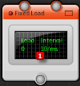
Evaluation
Experiment setup
  Amazon EC2 Cloud
Data
Notes:
To introduce different service-specific parameters, we created our own services that execute matrix multiplication operation. We distinguished seven different service classes by the amount of memory that is required for the service to execute its task. More specifically, all the services perform matrix multiplication operation but different classes operate on different matrices ranks. Then, we deployed services in different regions on the Amazon EC2 Cloud.
To introduce different user-specific parameters, we simulated users by placing instances of the loadUI tool, intended for services stress-testing. The instances were running as distribute agents in the different regions of the Amazon EC2 cloud, waiting for the tasks to be delivered and executed.
To introduce different environment-specific parameters we created different test cases using different load generators supported by the loadUI tool. Different load generators use different interval between sending each invocation.
During the test case the each agent performed 150 service invocations to each deployed service. Once the test case was done, the data was collected and machines hosting web services were restarted in order to fully recover for the next test case.

Slide 20
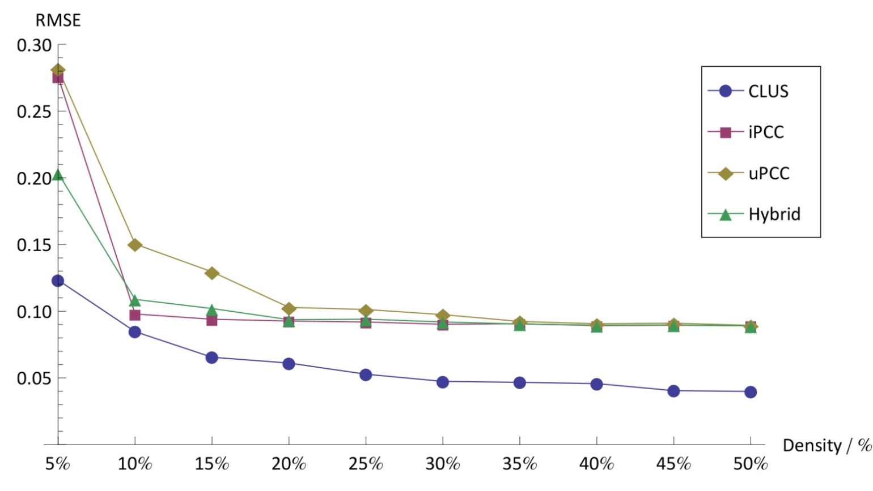
Evaluation
Results – Impact of data density
  Prediction accuracy – with load intensity
Notes:
In the first experiment we analyzed the impact of the collected data density on both prediction accuracy and prediction performance for all competing approaches. The results of data density impact on prediction accuracy in the environment with load intensity show the RMSE values in relation to data density for all competing approaches. Second, the CLUS approach obviously outperforms competing approaches for each data density. At the density of 50% obtains at 56% lower RMSE value than the Hybrid approach.

Slide 21
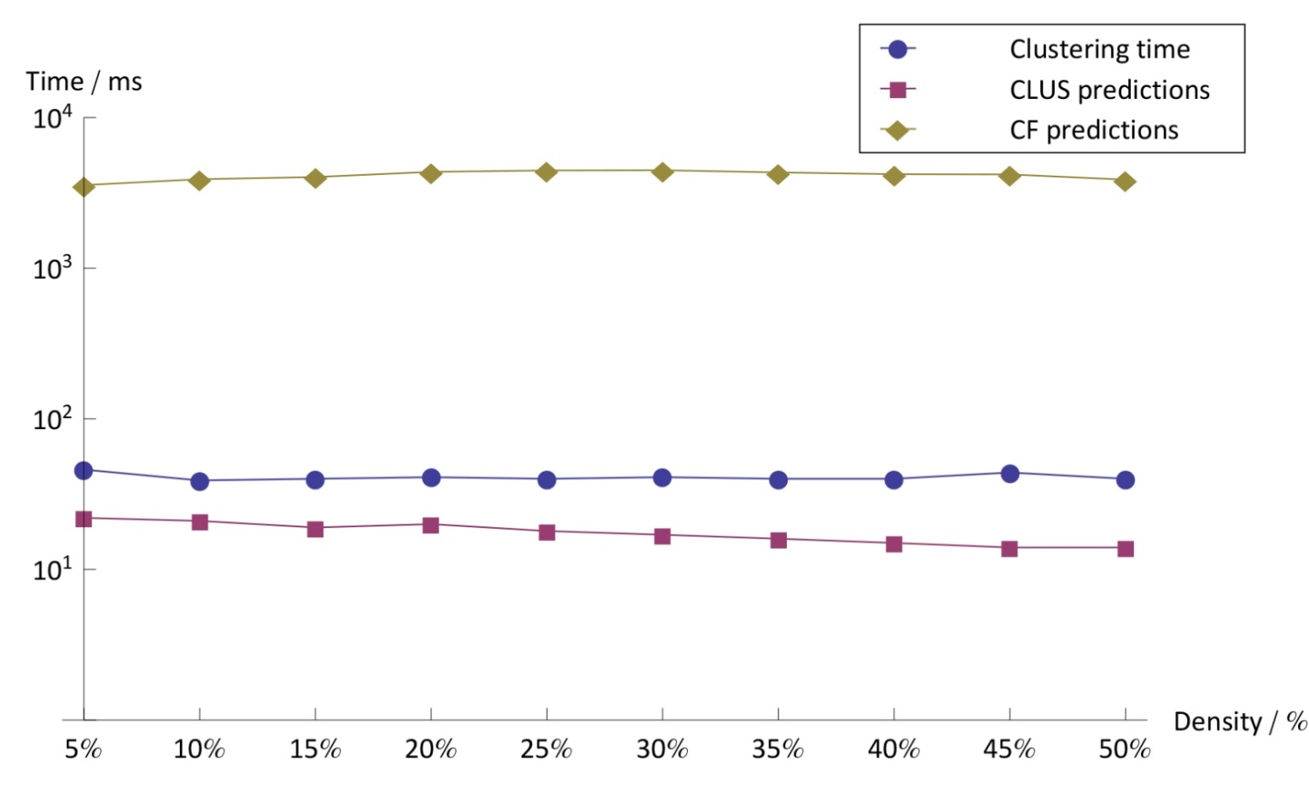
Evaluation
Results – Impact of data density
  Prediction performance – with load intensity
Notes:
The results of data density impact on the prediction performance in the environment with load intensity are presented in figure. The figure presents the aggregated prediction time for the whole test set in milliseconds in relation to the data density for CLUS and collaborative filtering representative – the Hybrid approach in the logarithmic scale.
As already presented (remember the overview) the CLUS approach is done in two phases: data clustering and prediction phase. Hence, we present separately Clustering time and CLUS predictions time for both phases. As can be seen in the figure, CLUS approach provides better prediction performance for at least two orders of magnitude when compered to the collaborative filtering. Also, CLUS prediction and clustering time is relatively stable regardless the data density, while collaborative filtering prediction time significantly changes for different densities.

Slide 22
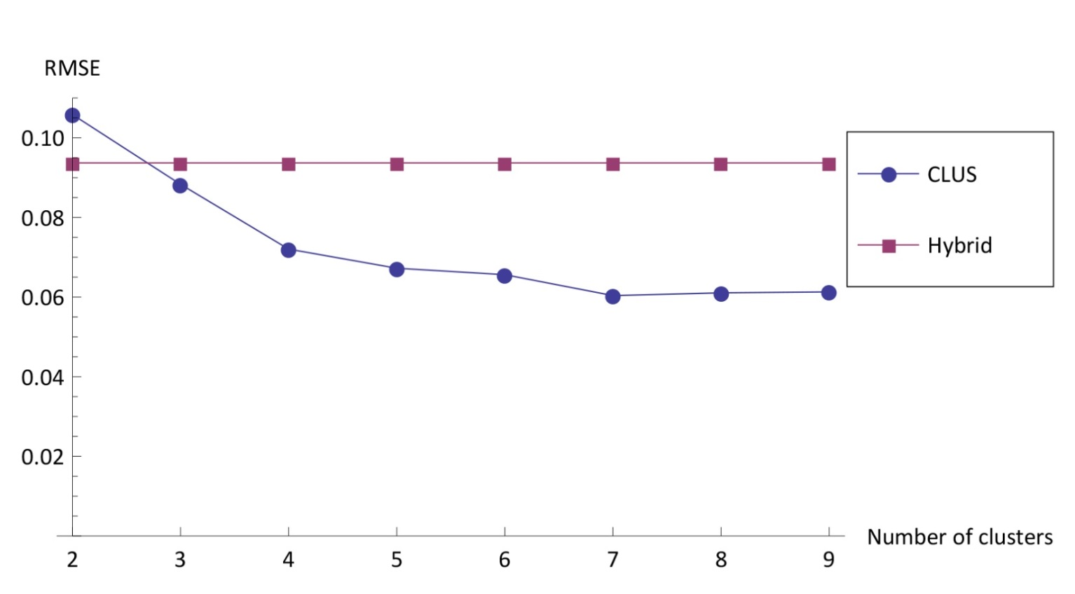
Evaluation
Results – Impact of number of clusters
  Prediction accuracy, Data density = 20%
Notes:
In the second experiment we study the impact of number of clusters on prediction accuracy and prediction performance. The figure presents the impact of number of clusters on prediction accuracy for the data density of 20%. The x axis presents different number of clusters while y axis shows the RMSE values for CLUS and CF representative – the Hybrid approach. The Hybrid approach prediction is not influenced by the number of clusters, while CLUS approach prediction accuracy is improving as the number of clusters increases.

Slide 23
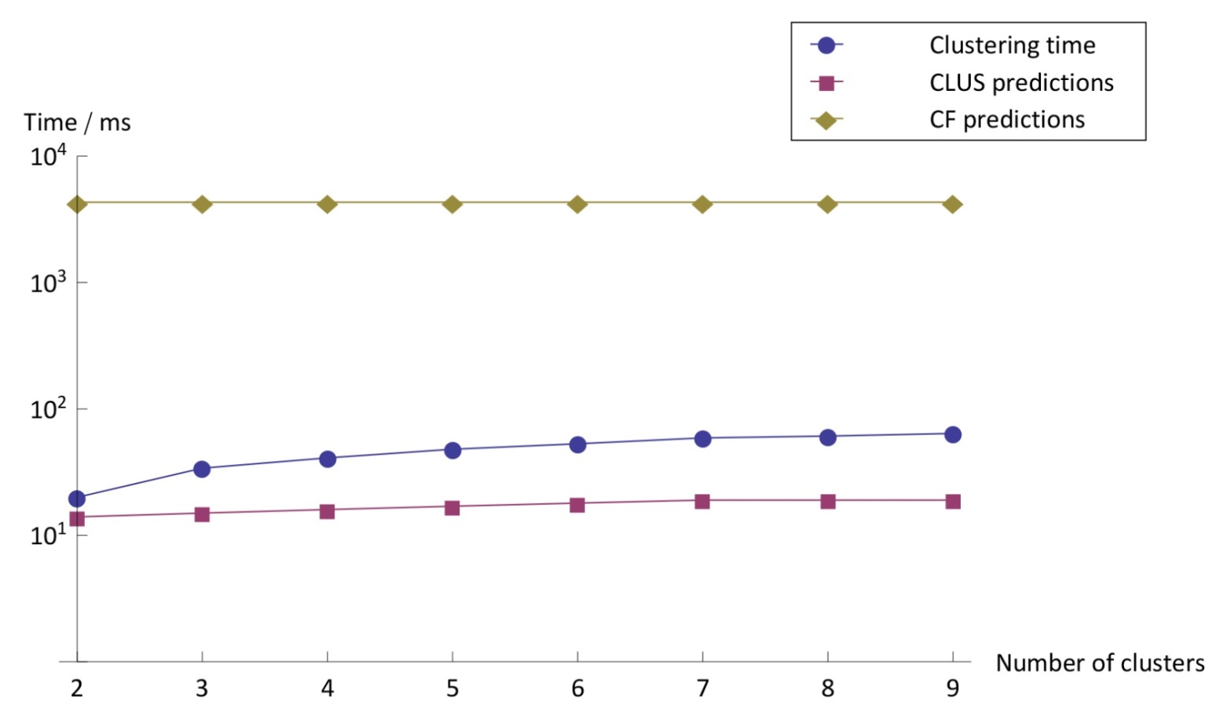
Evaluation
Results – Impact of number of clusters
  Prediction performance, Data density = 20%
Notes:
This figure presents the impact of number of clusters on prediction performance for the data density of 20%. The results present aggregated prediction time for the whole test set in the relation to the number of clusters in milliseconds for CLUS and CF representative – the hybrid approach in the logarithmic scale. The Hybrid performance is not influenced by the number of clusters. However, the CLUS approach’s both prediction and clustering phase time grow as the number of clusters grows. Knowing the computational complexity of K-means clustering, this behavior is quite expected.

Slide 24
Conclusion
Proposed a CLUS approach
Improved the prediction accuracy
  By introducing environment-specific parameters
  At least 56% lower RMSE value than the state-of-the-art
Improved the prediction performance
  By applying principle of aggregation
  Execution time reduced for two orders of magnitude when compared to the state-of-the-art
Flexibility of approach
  Trade-off between accuracy and scalability
  Can be applied in different environments
Notes:
To conclude, we proposed a novel approach for prediction of atomic web services reliability based on the previous invocation data. We conducted the experiment in which we compared different quality aspects of our approach to the state-to-of-the-art. We improved the prediction accuracy by introducing environment-specific parameters. CLUS approach obtains at least 56% lower RMSE value than the state of the art. Furthermore, we improved the prediction performance, by applying the principle of aggregation and thus reducing the execution time for at least two orders of magnitude when compared to the state of the art. With such characteristics, the approach can be applied in different environments.

Slide 25
Q&A
Thanks the audience for listening.

